Slide 1

Load/Performance/Stress Testing Web Services
www.pragmatic.bg
Lector: Dimitar Topuzov
E-mail: dtopuzov@gmail.com
LinkedIn: http://bg.linkedin.com/pub/dimitar-topuzov/18/470/833/en
Copyright © Pragmatic LLC 2015

Slide 2
Content
Difference between Performance/Load/Stress
Best practices in Performance/Load/Stress Testing
Review of tools
SoapUI
JMeter
Demos and practice with JMeter
Install
Create Project
Getting Started

Slide 3
Performance/Load/Stress
Performance Testing
How fast is the system?
Load Testing
How much load can the system process?
Stress testing
Testing with conditions beyond the normally expected ones
Under what conditions the system will fail?
Notes:
http://agiletesting.blogspot.com/2005/02/performance-vs-load-vs-stress-testing.html

Slide 4
Performance Testing
Determines or validates the speed, scalability, and/or stability characteristics of the system
The goal of performance testing is not to find bugs, but to:
Eliminate bottlenecks
Establish a baseline for future regression testing
Determine compliance with performance goals and requirements
Usually performed over a software that is already stable enough
Notes:
http://agiletesting.blogspot.com/2005/02/performance-vs-load-vs-stress-testing.html

Slide 5
Performance Testing
Performance testing metrics
Requests Per Second
Bytes Per Second
Latency
Maximum Concurrency
Resources
Performance metrics explained

Slide 6
Load Testing
What is Load Testing?
Testing performance characteristics of an application under specific volumes of load
Load testing goals is to identify:
How many users application/hardware can handle with optimal performance results
The upper limit of the system in terms of database, hardware and network etc
Adequacy of environment

Slide 7
Load Testing
Load testing metrics
Average Response Times
Peak Response Times
Error Rates
Throughput
Requests per Second
Concurrent Users
Resources
Load Testing metrics explained

Slide 8
Stress Testing
What is Stress Testing?
Determining an application’s robustness, availability, and reliability under extreme levels of load
Testing while the product is subjected to other stressful conditions
E.g., limited memory, insufficient disk space or server failure
Goals of Stress Testing
Identify application issues that arise or become apparent only under extreme conditions
Heavy loads, high concurrency, or limited computational resources, etc.
Notes:
http://msdn.microsoft.com/en-us/library/bb924374.aspx
http://blog.browsermob.com/2008/12/performance-vs-load-vs-stress-testing/
http://searchsoftwarequality.techtarget.com/answer/Understanding-performance-load-and-stress-testing

Slide 9
Stress Testing
Example of Stress testing:
A banking application can take a maximum user load of 20000 concurrent users.
Increase the load to 21000 and do some transaction like deposit or withdraw.
As soon as you did the transaction, banking application server database will sync with ATM database server.
Now check with the user load of 21000 does this sync happened successfully.

Slide 10
Please have this in mind…
Performance/Load/Stress testing require a lot more knowledge compared to functional testing
OS
Networking
Hardware

Slide 11
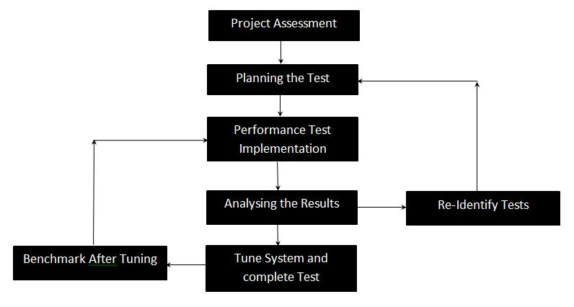
Performance/Load/Stress Testing Workflow
Notes:
https://msdn.microsoft.com/en-us/library/bb924359.aspx

Slide 12
Best Practices (1)
Planning the Test is more important than actual implementation !
Planning the Test is more mathematics then testing
Planning involves a lot of calculations
Number of users under average load
Calculate pick loads
Calculate think times

Slide 13
Best Practices (2)
Start Performance/Load/Stress testing only if systems works correctly (functional tests passed)
Make sure you have stable Environment
Environment must have same resources during each test execution
No other random actions should be done during performance/load/stress tests
If possible use same hardware resources as Live System
If possible use separate environment (specially when perform stress tests)

Slide 14
Best Practices (3)
Base testing scenarios on real data (if possible)
In best case use data from some analytics/monitoring solution that give you meaningful data in easy way
If you have no analytics/monitoring solutions try to introduce such
If there is no chance for analytics/monitoring try to find some kind of logs of the SUT and try to analyze them
Guess only as a last resort
(If Guess) Think about real scenarios
How many users will go through different workflows
Some operations/features might be used much more than other

Slide 15
Best Practices (4)
Use some kind of concurrency calculator
Sample Calculator
How to calculate VU (article)
How to calculate VU (another article)
How to calculate VU (one more article)
Use think times (with deviations)
It not only mimics real world usage better, but it allows for your agents I/O to not be as congested

Slide 16
Best Practices (5)
Test Data
Make sure you have enough random data for each virtual user
Make sure your test data is close to live data in terms of size and content
Specially in case test data is big (images, videos)

Slide 17
Best Practices (6)
(For Load Testing) Use ramp times to build up your users from a small number to larger numbers
In this way you will find the critical point at which system stops working as expected
Use more Agents if needed
The more agent machines you use, the more networking ports you can use at any one time, freeing up congestion on the agent side.

Slide 18
Load Testing with SoapUI
SmartBear offering
SoapUI
Can be used only for simple scenarios
Does not support distributed load testing
LoadUI
Free edition with virtual user limit
PRO version for serious load testing
Support distributed load testing
Demo with SoapUI Free
Change number of users and monitor results

Slide 19
Monitoring OS
Windows
Task Manager
Recourse Monitor (resmon)
Tutorial
Performance Monitor (perfmon)
Linux / OSX
“top” command
Tutorial 1
Tutorial 2
Notes:
protocols

Slide 20
JMeter Features Overview
JMeter
Free (open source)
Java Desktop Application (cross-platform)
Support a lot of protocols
HTTP, SMTP, POP3, LDAP, JDBC, FTP, JMS, SOAP, TCP
Support distributed load testing
There are services which can run your JMeter tests from the cloud
Notes:
protocols

Slide 21
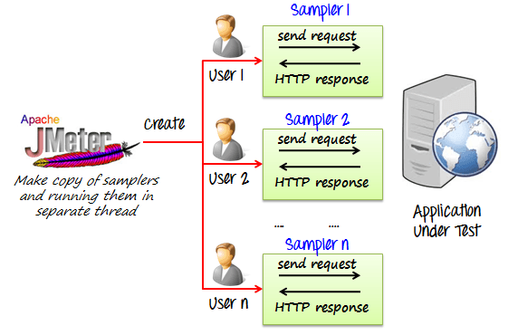
Load Testing with JMeter
How JMeter Works

Slide 22
Load Testing with JMeter
Requirements
JDK 1.6 +
Hardware: Depends on what we want to simulate
Installation
Install JDK
Add JDK to Path (if not already added)
Verify installation by running “java -version” on command prompt
Install JMeter
Download
Extract
(Optional) Add to Path

Slide 23
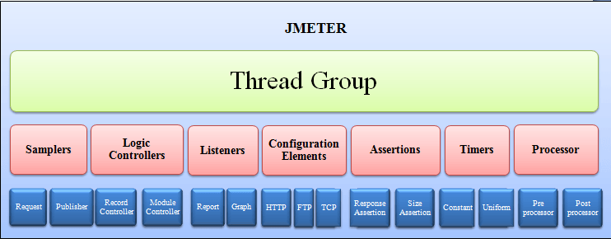
Load Testing with JMeter
JMeter elements schema

Slide 24
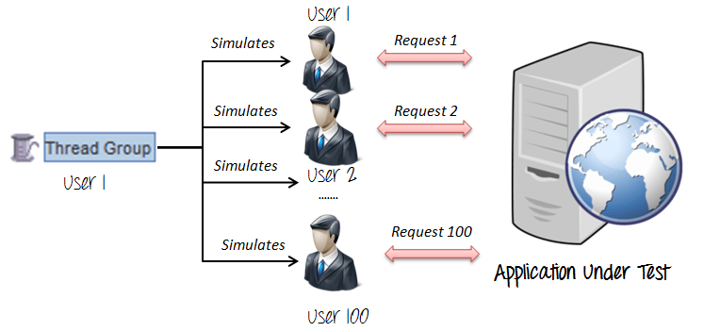
Load Testing with JMeter
Thread Group
Thread Groups is a collection of Threads
Each thread represents one user using the application under test

Slide 25
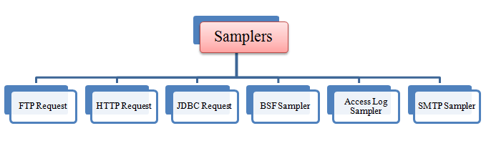
Load Testing with JMeter
Samplers
Sampler is type of Request (Protocol) we want to use in our tests
HTTP, FTP , JDBC, POP3 …

Slide 26
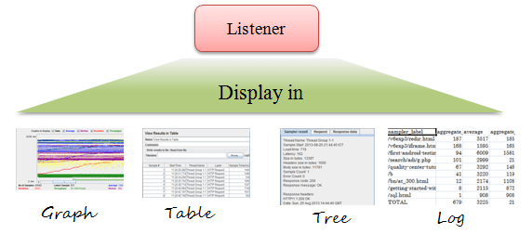
Load Testing with JMeter
Listeners
Shows the results of the test execution
They can show results in different format such as tree, table, graph or log file

Slide 27
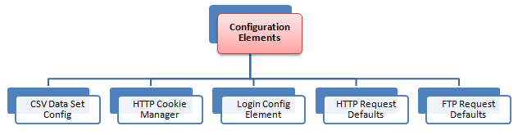
Load Testing with JMeter
Configuration Element
Set up defaults and variables for later use by samplers

Slide 28
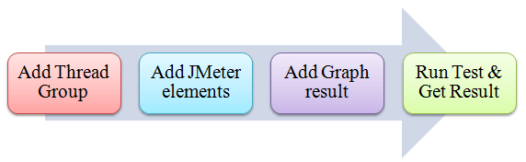
Load Testing with JMeter
JMeter project workflow

Slide 29
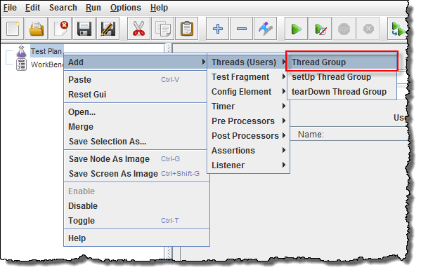
Load Testing with JMeter
Add Thread Group
Start JMeter
Select Test Plan on the tree
Right click on the Test Plan and add a new thread group: Add -> Threads (Users) -> Thread Group

Slide 30
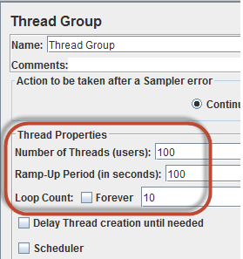
Load Testing with JMeter
Thread Group Properties
Number of Threads
Number of users connects to target website/service
Loop Count
Number of time to execute testing
Ramp-Up Period
Delay before starting next user

Slide 31
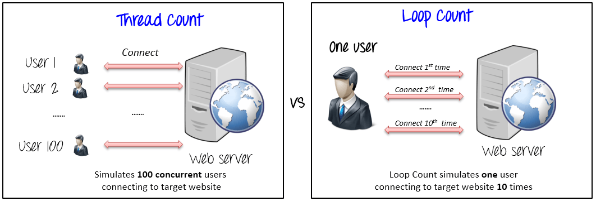
Load Testing with JMeter
The Thread Count and The Loop Counts are different

Slide 32
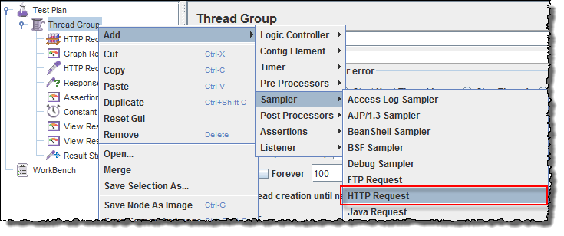
Load Testing with JMeter
Adding JMeter elements
Right-click on Thread Group and select: Add -> Sampler -> HTTP Request.

Slide 33
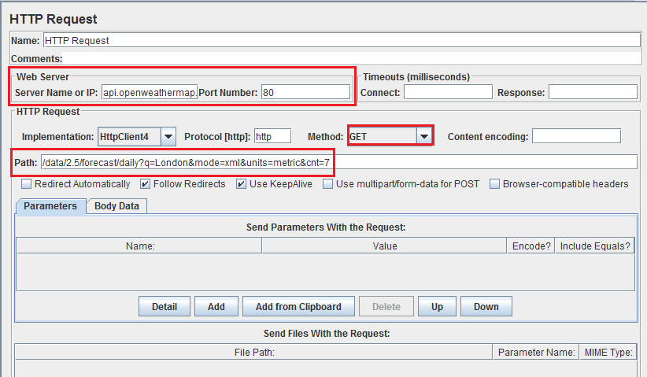
Load Testing with JMeter
HTTP Request

Slide 34
Load Testing with JMeter
How to use Timers in Jmeter
Constant Timer
Thread Group -> Timer -> Constant Timer
Delays each user request for the same amount of time
Gaussian Random Timer
Gaussian random timer delays each user request for a random amount of time
Uniform Random Timer
Uniform random timer delays each user request for a random amount of time.

Slide 35
Load Testing with JMeter
How to use Assertions in JMeter
Assertion help verify that your server under test returns the expected results.
Commonly used Assertion in JMeter
Response Assertion
Thread Group -> Add -> Assertions -> Response Assertion
Assert Response contains Text
Assert Response Status Code is correct
Duration Assertion
Size Assertion
XML Assertion
HTML Assertion

Slide 36
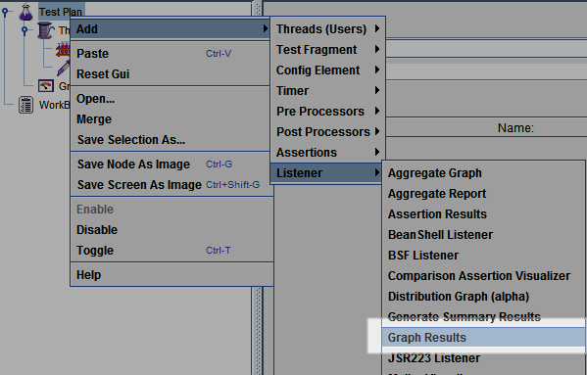
Load Testing with JMeter
Adding Graph Results
Right click Test Plan, Add -> Listener -> Graph Results

Slide 37
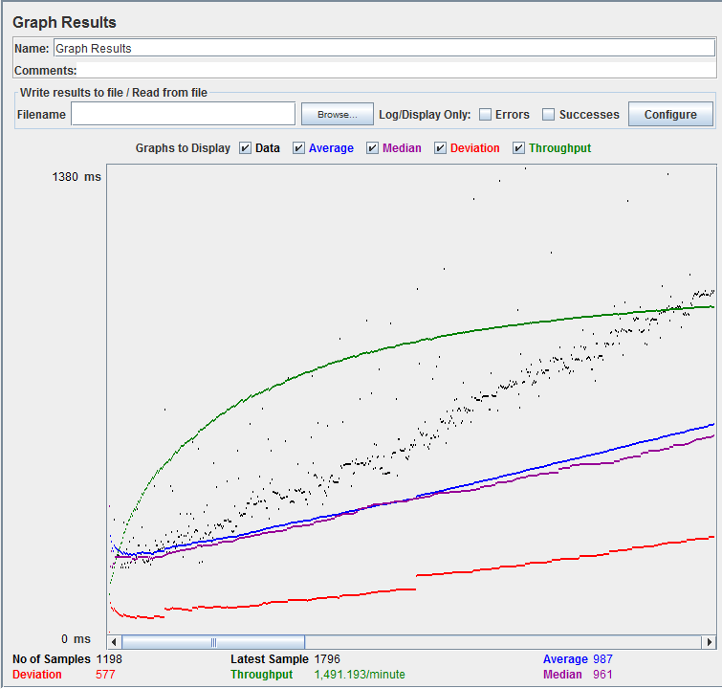
Load Testing with JMeter
Run Tests and get results
Press Run button (Ctrl + R) on Toolbar to start the testing process. You will see the test result display on Graph at the real time.

Slide 38
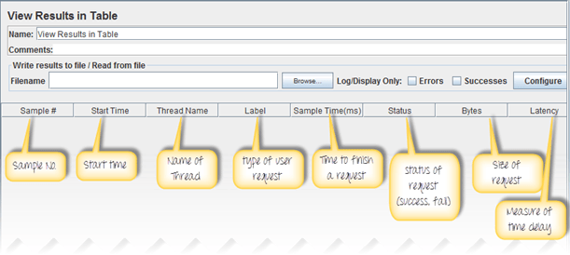
Load Testing with JMeter
View Results in Table
Right click Add -> Listener -> View Result in Table

Slide 39
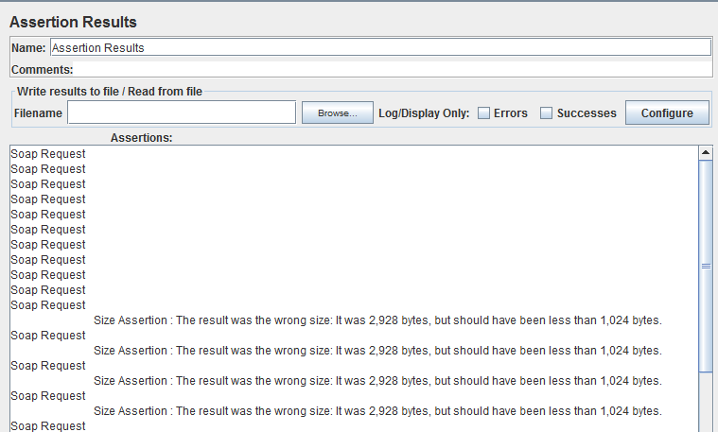
Load Testing with JMeter
View Assertion Results
Right click Thread Group, Add -> Listener -> Assertion Results

Slide 40
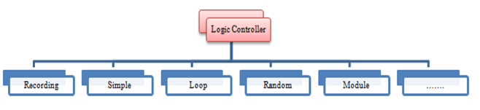
Load Testing with JMeter
Logic Controllers
Logic Controllers let you define the order of processing request in a Thread
Logic Controllers determine the order in which user request are executed

Slide 41
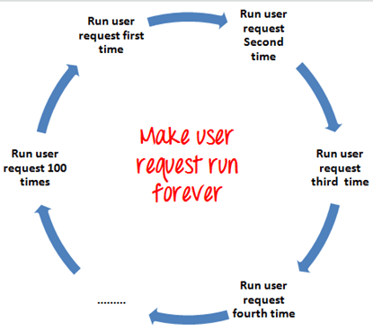
Load Testing with JMeter
Loop Controller
Loop Controller makes the user request run specified number of times or run forever as shown in figure

Slide 42
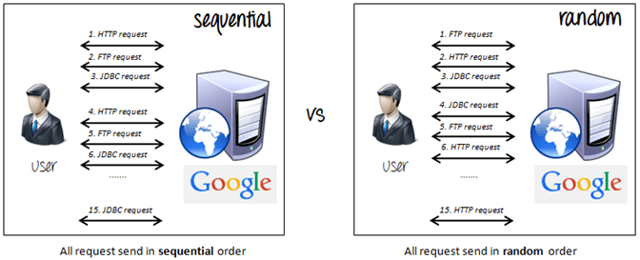
Load Testing with JMeter
Random Controller
Random Controller makes all the user requests run in random order in each loop period

Slide 43
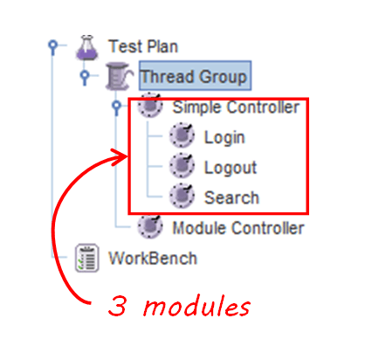
Load Testing with JMeter
Module Controller
The goal of Module Controller is to add modularity to JMeter

Slide 44
Load Testing with JMeter
Hints for Reducing Resource requirements
Use non-GUI mode: jmeter -n -t test.jmx -l test.jtl
Use as few Listeners as possible; if using the -l flag as above they can all be deleted or disabled.
Use CSV output rather than XML
Only save the data that you need
Use as few Assertions as possible

Slide 45
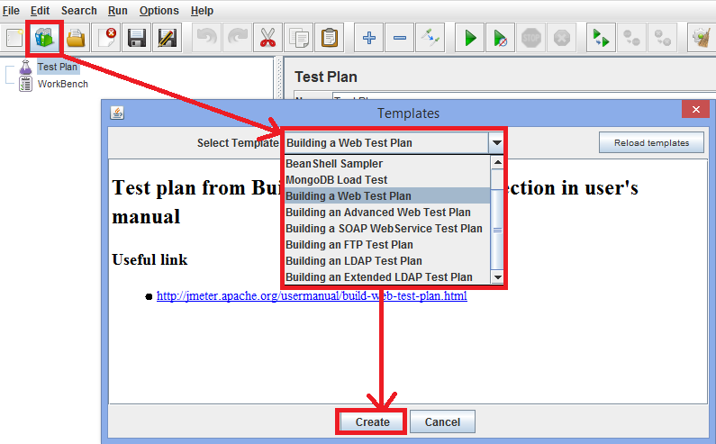
Load Testing with JMeter
Build-in Templates

Slide 46
Load Testing with JMeter
Plugins
JMeter Plugins
PerfMon Metrics Collector and Server Agent can be used for automated monitoring of servers during load/stress test

Slide 47
Tutorials
Official Documentation
The Ultimate Jmeter Tutorial
Tutorial for Distributed Load Testing
Notes:
protocols

Slide 48

Questions

